Slide 1




Presentation of
EXAMINATION
SYSTEM
Dep. Head : Eng. Rami
Superviosr : Eng. Sara Salah

Slide 2








Our Team
Mohamed
Shoreif
Mostafa
Hussein
Kareem
Amr
Mariam
Ayman
Abdelrahman
Hamdy

Slide 3

INTRODUCTION
This project is an automated examination system designed to streamline the process of exam generation, answering, and grading using data-driven methods. It leverages Power BI for intuitive dashboard visualizations, Python for efficient data generation, SQL for managing stored procedures, and SSRS for comprehensive reporting, offering a seamless and efficient experience for both administrators and users.

Slide 4




Project Aim
Facilitate Exam Generation: Develop a system that streamlines the process of generating Exams
01
Question variation :
the question is assigned to be vary from Multiple choices and True or False to support
exam efficiency
02
Flexible Question Usage:
Allow questions to be reused multiple times while ensuring that not all questions are included in every exam
03

Slide 5





Phase 4
Power BI
Dashboard
Phase 3
Project phases
SSRS
Phase 2
Database Creation & Data Insertion
Phase 1
ERD & Mapping

Slide 6
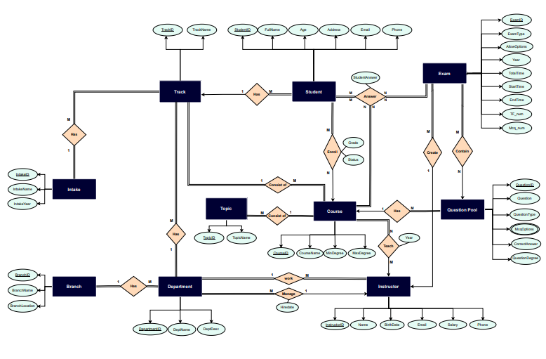
ERD

Slide 7
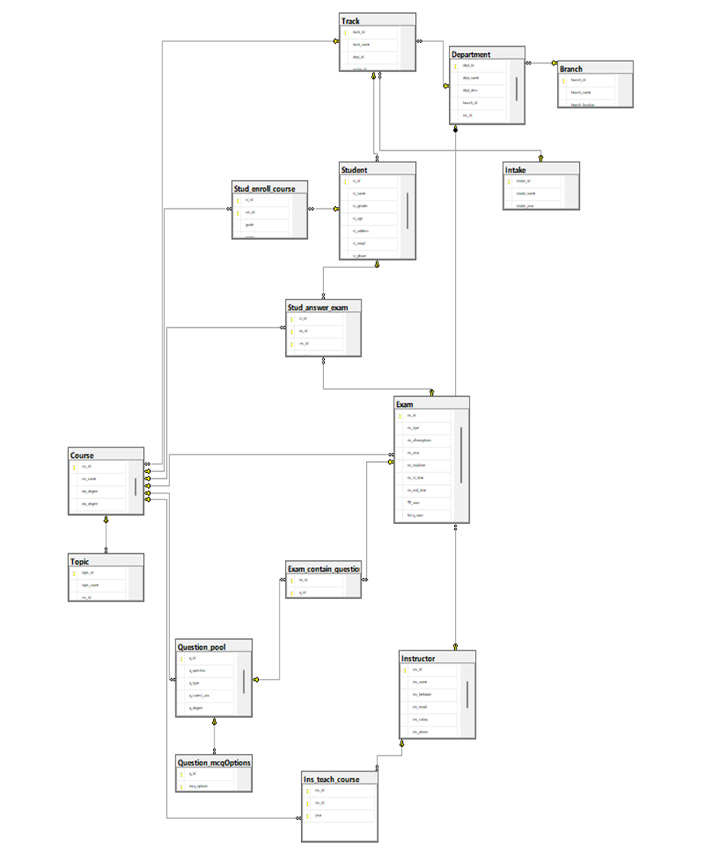
DATABASE DIAGRAM

Slide 8
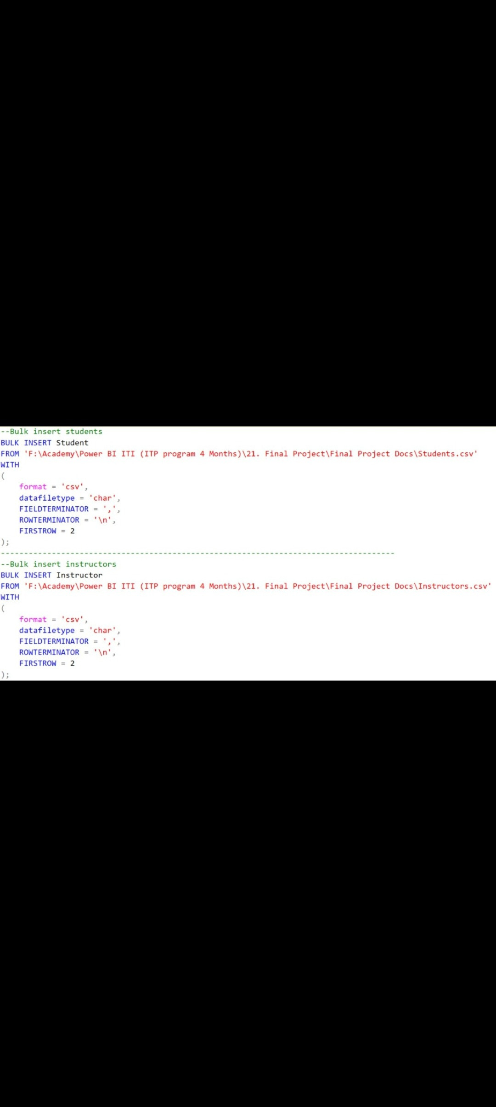
Data acquisition using python generated data in student & instructor tables using bulk insert
DATA
INSERTION

Slide 9
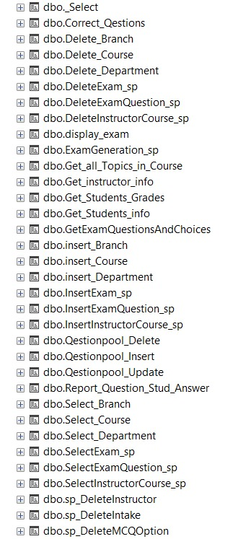
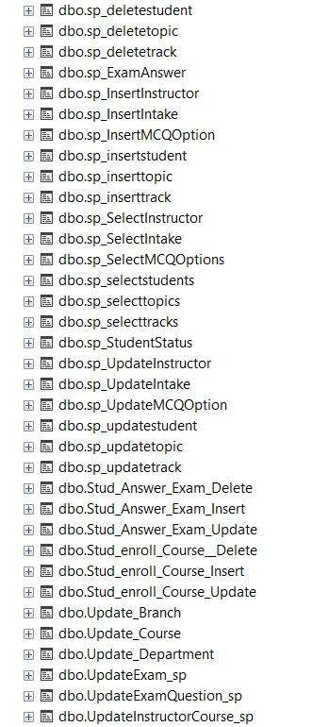
Insert
Update
Delete
Select
SP
Exam
Report

Slide 10
Report
Student’s Personal Information Report
Students Grades Report
Instructor’s Personal Information Report
Course’s Topics Report
Question Student Answer Report
Student Exam

Slide 11
ADMIN
USER 1 ---→ Student
USER 2 ---→ Instructor

Slide 12
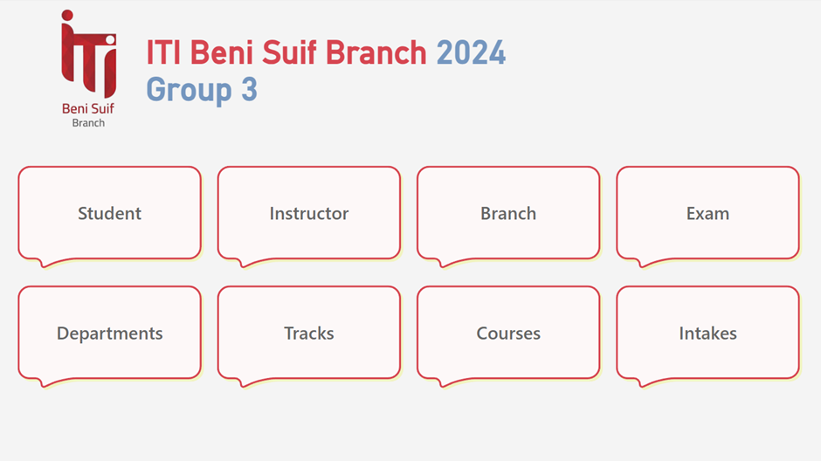
This dashboard offers an overview of key topics and acts as a central hub, guiding users to navigate through other related dashboards.
Dashboard

Slide 13
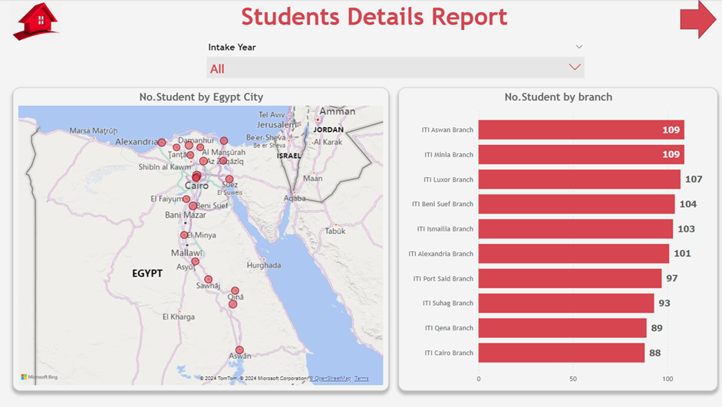
Displays the student count for each branch, accompanied by an interactive map that highlights the location of each branch for easy reference
Student

Slide 14
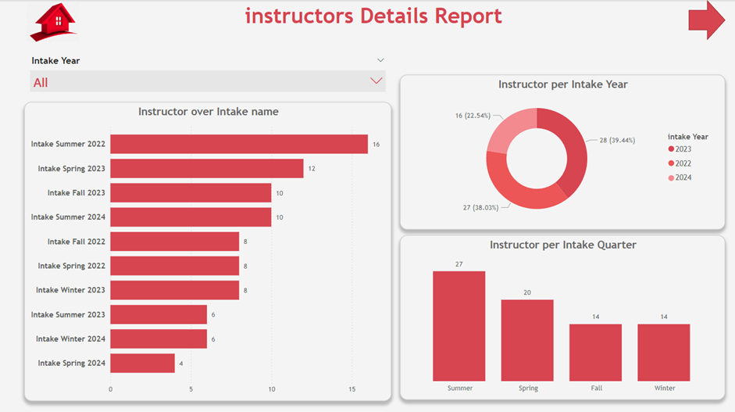
This dashboard displays the number of instructors in each intake round, along with their distribution across intake years and quarters.
Instructor

Slide 15
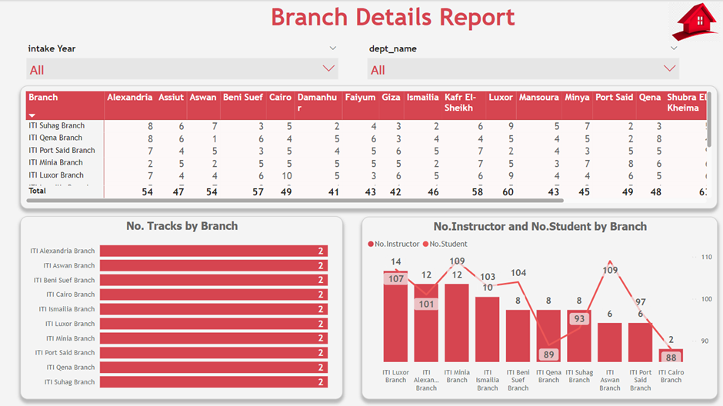
This dashboard presents detailed information for each branch, including the number of instructors and students, offering a comprehensive view of faculty and student distribution across branches.
Branch

Slide 16
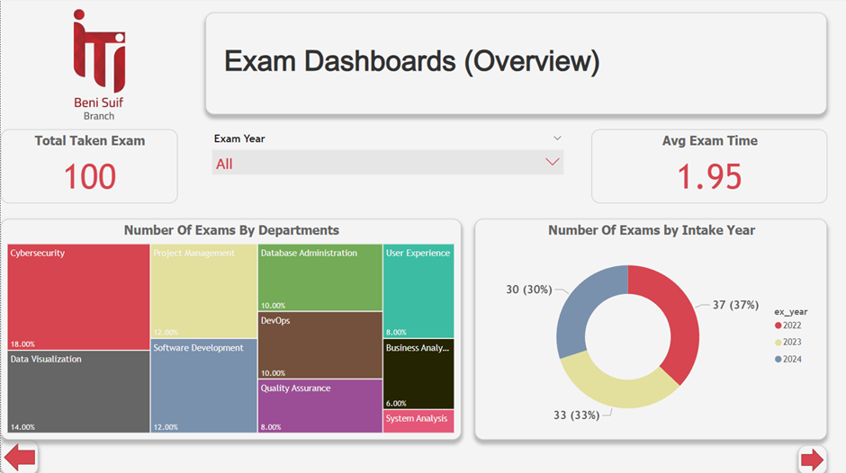
This dashboard provides an overview of exam statistics, including the average exam duration and the total number of exams for each department, offering valuable insights into departmental assessment activities.
Exam

Slide 17
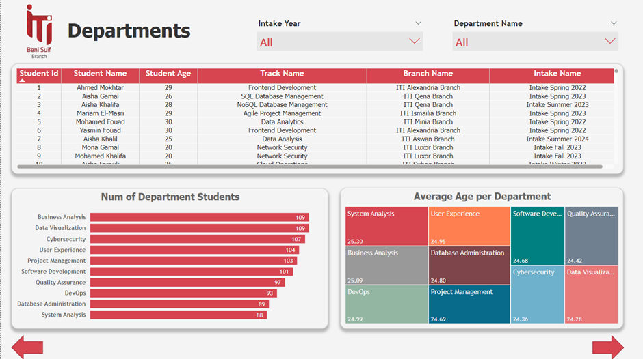
This dashboard presents departmental information, including the tracks offered, the number of students in each department, and their average age, providing a comprehensive view of student demographics across departments.
Department

Slide 18
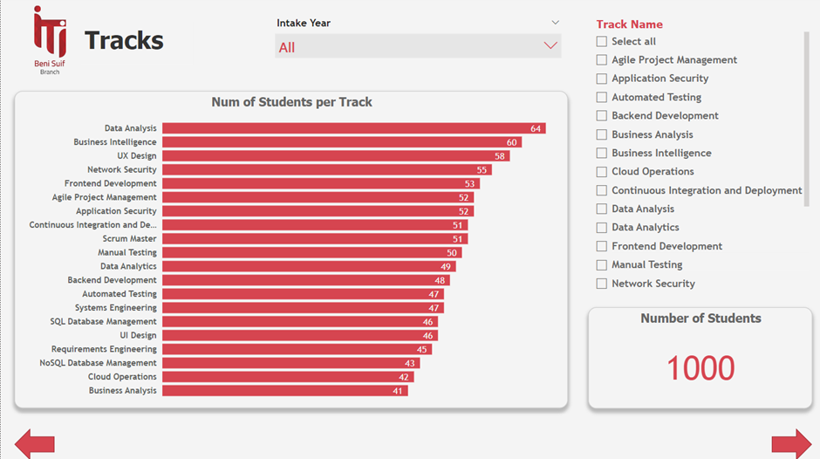
This dashboard displays the number of students in each track, along with the total student count, offering a clear overview of enrollment distribution.
Tracks

Slide 19
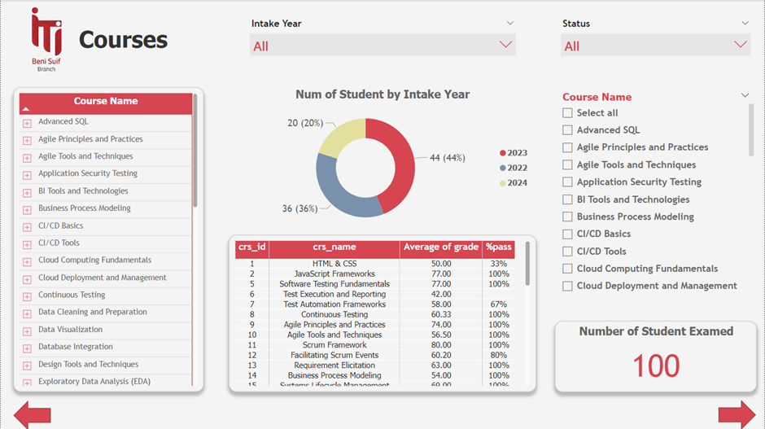
This dashboard presents detailed information for each course, including the number of students enrolled by intake year, providing insights into course popularity and enrollment trends.
Courses

Slide 20

THANK YOU

